Slide 1
By Cathy Chen
CMSC 621, Fall 2007

Slide 2
Outline
What is P2P Network?
Overlay Network centralization
Purely Decentralized Architectures
Partially Centralized Architectures Hybrid
Decentralized Architectures
Network Structure
Unstructured Structured
Unstructured Architectures
Hybrid Decentralized Purely Decentralized
Partially Centralized
Structured Architectures
Freenet - A Loosely Structured System
Chord
Can (Content Addressable Network) Tapestry

Slide 3
What is P2P Network?
A distributed network composed of a large number of distributed, heterogeneous, autonomous, and highly dynamic peers in which participants share a part of their own resources such as processing power, storage capacity, software, and file contents.
The participants in the P2P network can act as a server and a client at the same time.
They are accessible by other nodes directly, without passing intermediary entities.

Slide 4
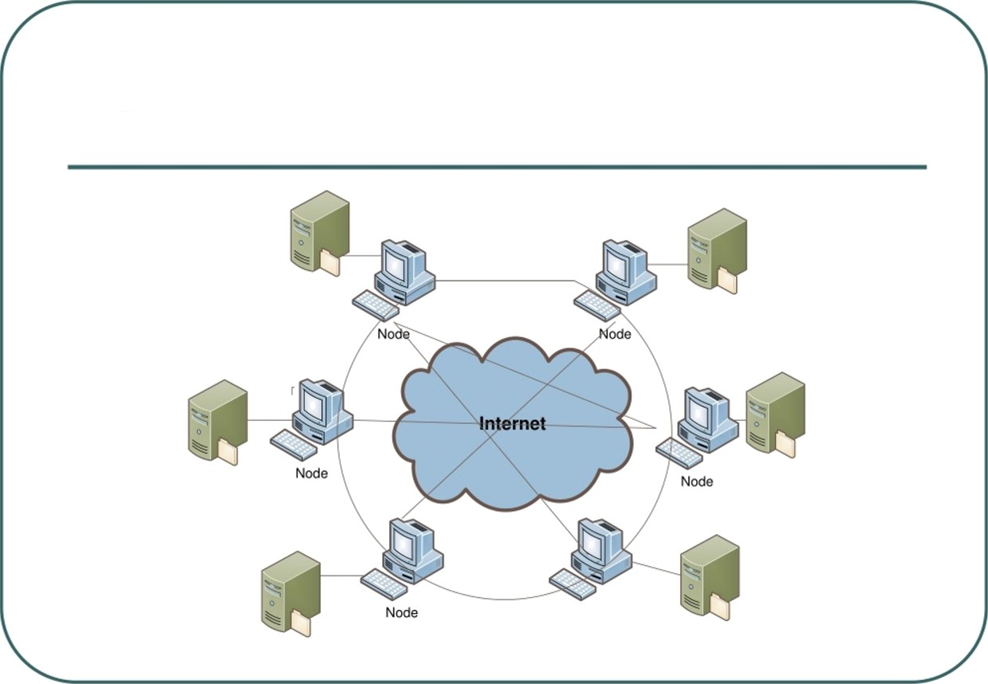
P2P Network
Node
CMSC 621, Fall 2007

Slide 5
P2P Architecture
Although in purest form peer-to-peer overlay networks are supposed to be totally decentralized, in practice this is not always true, and systems with various degrees of centralization are encountered.
They are identified into the following three categories:
  − Purely Decentralized architectures
  − Hybrid decentralized architectures
  − Partially Centralized architectures

Slide 6
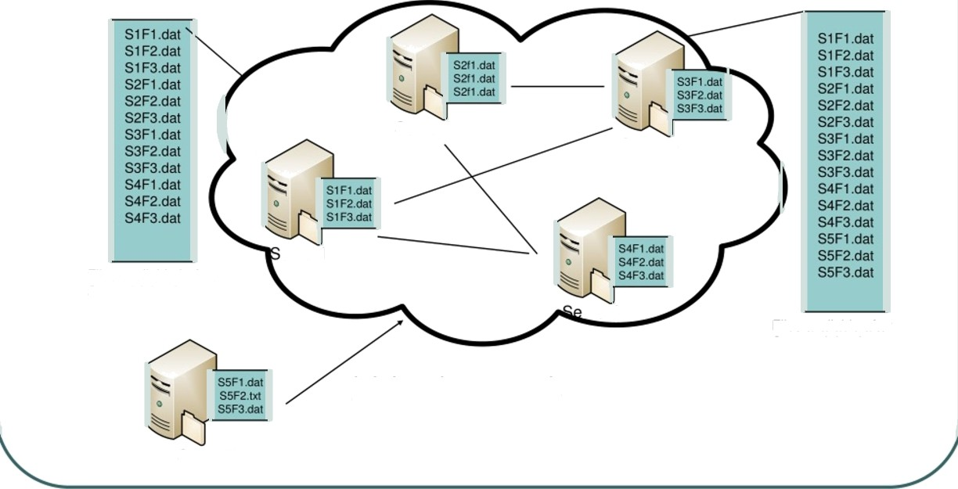
Purely Decentralized Architectures
Server2
Server3
erver1
Files available before Server5 joined
rver4
Files available after Server5 joined
joining the nevork
Server5

Slide 7
Gnutella : Pure Decentralized System
P2P networking: applications connect to peer applications
Focus: decentralized method of searching for files
Each application instance serves to:
Store selected files
  Route queries (file searches) from and to its neighboring rs
  Respond to queries (serve file) if file stored locally
How it works - Searching by flooding:
  If you don't have the file you want, query 7 of your partners.
  If they don't have it, they contact 7 of their partners, for a maximum hop count of 10.
  Requests are flooded, but there is no tree structure.
  No looping but packets may be received twice.

Slide 8

Advantages and Disadvantages of Purely Decentralized Systems
Advantages
Inherently fault-tolerant, since there is no central point of failure and the loss of a peer or even a number of peers can easily be compensated.
Have a greater degree of autonomous control over their data and resources
Disadvantages
Slow discovery time
No guarantee about quality of services

Slide 9
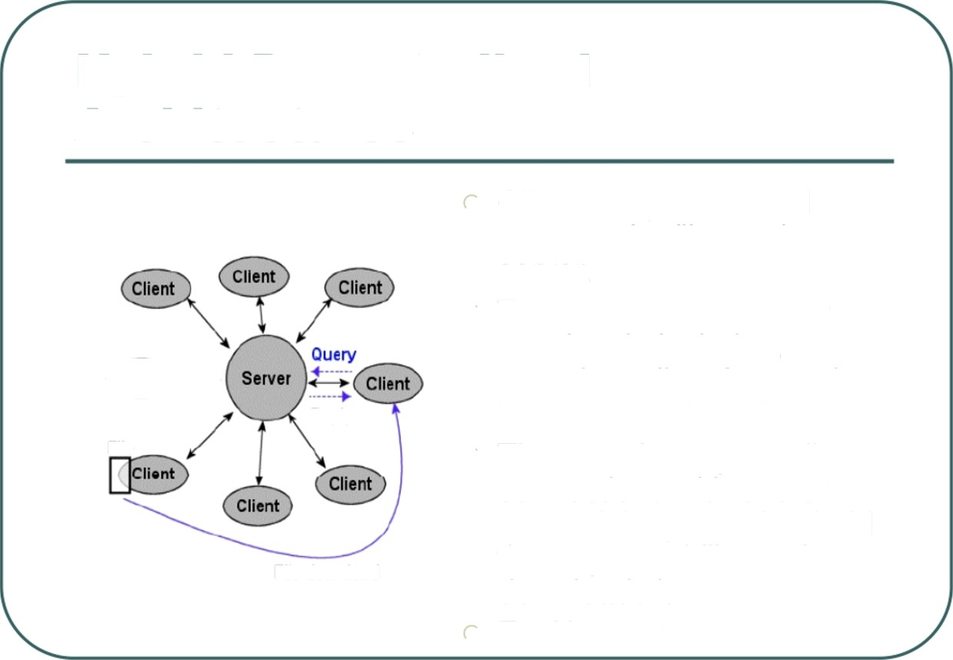

Hybrid Decentralized Architectures
Client computers send requests for files to the server.
The server searches for
matches in its index, returning a list of users that hold the matching file.
The user then opens direct connections with one or more of the peers that hold the requested file, and downloads it
Ex. Napster
Reply
File
File download

Slide 10
Hybrid Decentralized Architectures
Client computers send requests for files to the server.
The server searches for
matches in its index, returning a list of users that hold the matching file.
The user then opens direct connections with one or more of the peers that hold the requested file, and downloads it
Ex. Napster
Reply
File
File download

Slide 11

Napster
Application-level, client-server protocol over point to-
point TCP, centralized system
Retrieval: four steps
Connect to Napster server
Upload your list of files (push) to server.
Give sewer keywords to search the full list with. Select “best” of correct answers. (pings)
centralized server: single logical point of failure, can load balance among servers using DNS rotation, potential for congestion
no security: passwords in plain text, no authentication, no anonymity

Slide 12
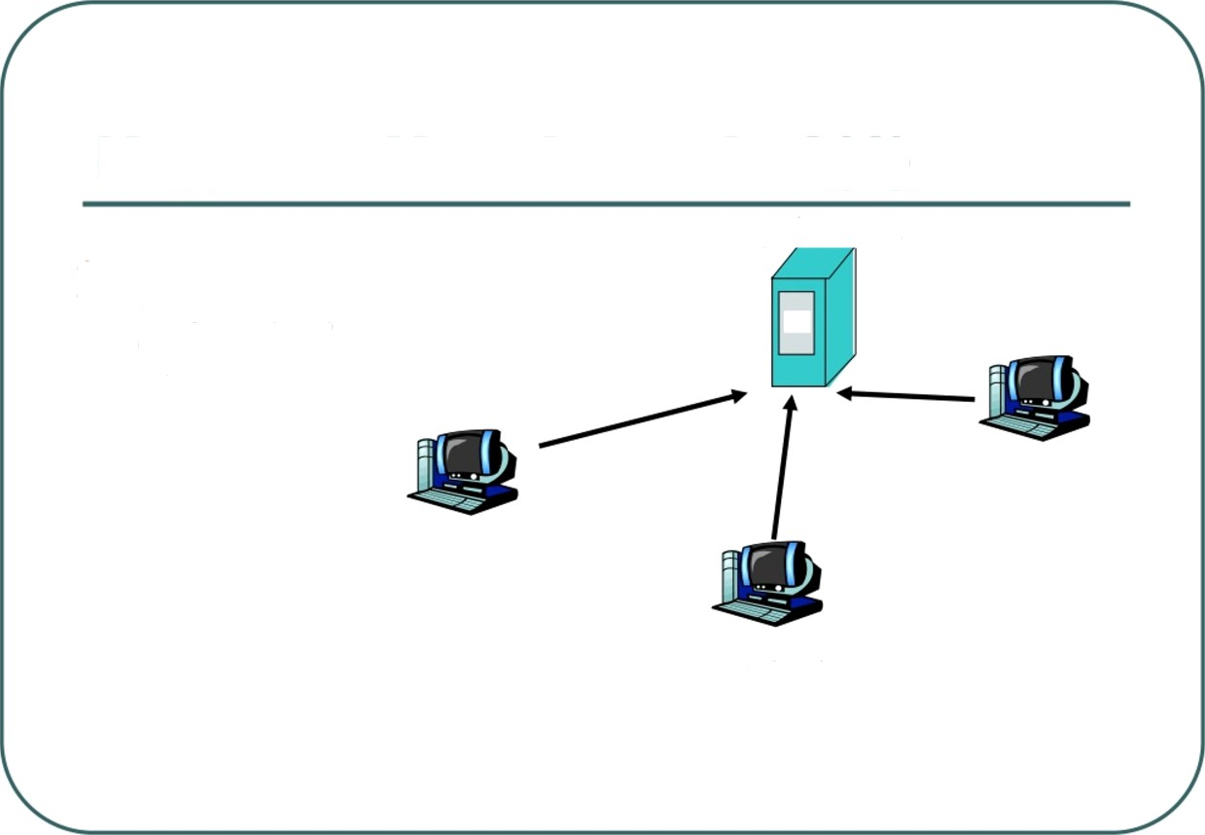
Napster: How it works?(1)
napster.com
1. File lis† is
uploaded
users

Slide 13
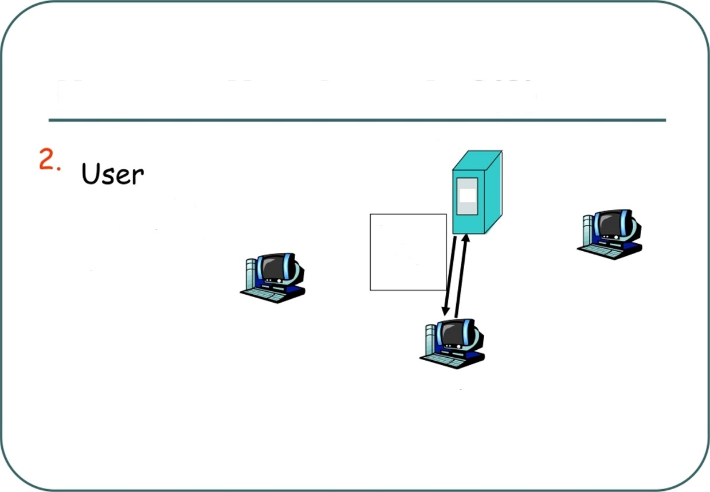
Napster: How it works?(2)
napster.com
requests search at server.
Reques† ond results
user

Slide 14
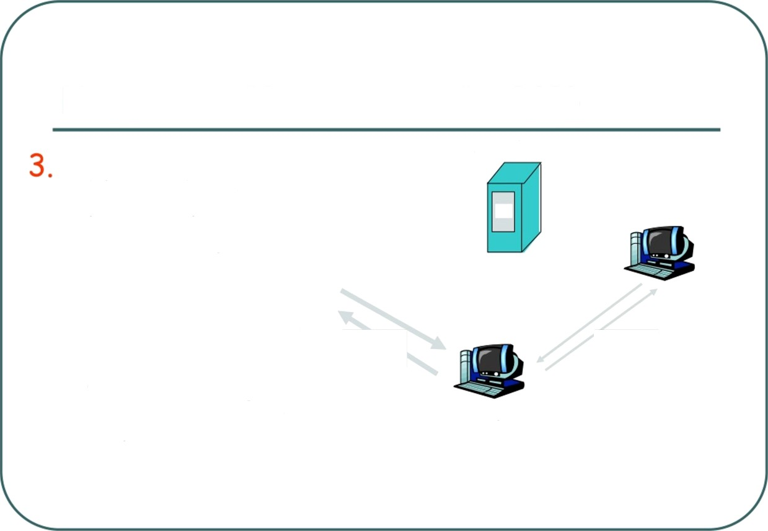


Napster: How it works?(3)
napster.com
User pings hosts that apparently have data.
Looks for bes† †roesfer
pings
user
rote.

Slide 15
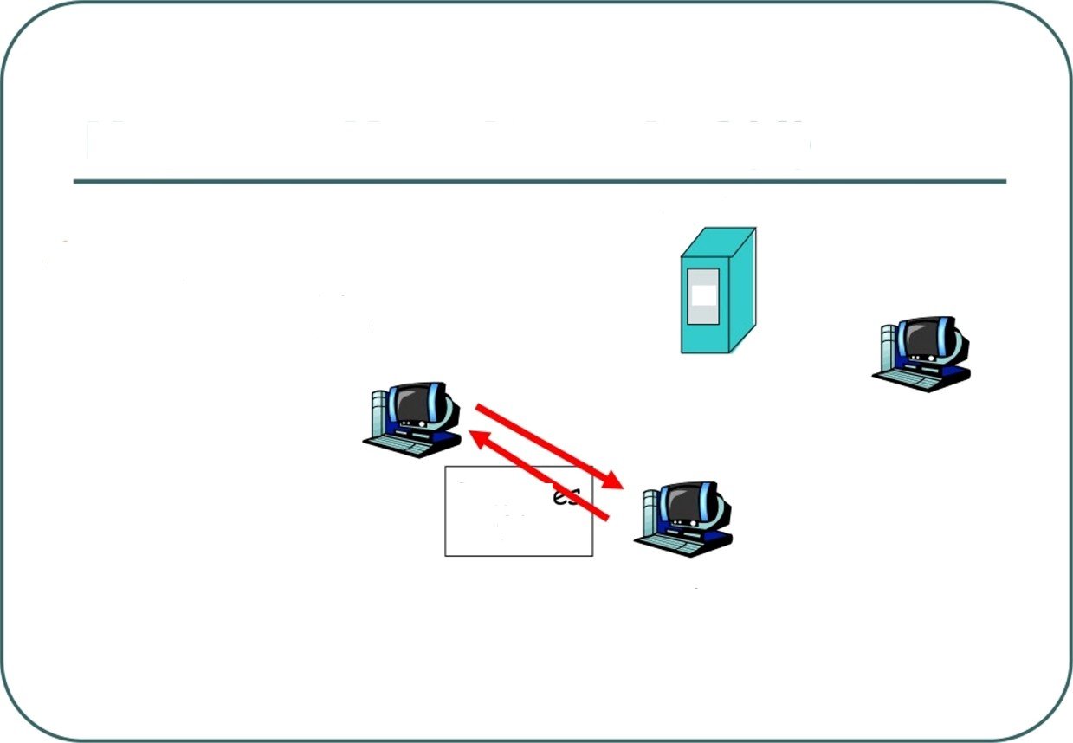
Napster: How it works?(4)
napster.com
4. User
retrieves file
Re†rieź
file
user
CMSC 621, Fall 2007

Slide 16

Advantages and Disadvantages of Hybrid Decentralized Systems
Advantages
Easy to implement
Locate files quickly and eñiciently
Disadvantages
Vulnerable to censorship, legal action, surveillance, malicious attack, and technical failure
Considered inherently unscalable as they are bound to be limitations to the size of the server database and its capacity to respond to queries.

Slide 17

Partially Centralized Architectures
use the concept of supernodes: nodes that are dynamically assigned the task of servicing a small subpart of the peer network by indexing and caching files contained therein.
Peers are automatically elected to become
supernodes if they have sufficient bandwidth and
processing power.
Supernodes index the files shared by peers
connected to them, and proxy search requests on behalf of these peers.
All queries are therefore initially directed to
supernodes.

Slide 18



Partially Centralized Systems
Kazaa and Morpheus are two similar partially centralized systems which use the concept of “SuperNodes".
In Morpheus a central server provides new peers with a
list of one or more Supernodes with which they can
connect. SuperNodes index the files shared by peers connected to them, and proxy search requestes on
behalf of these peers. Queries are therefore sent to SuperNodes, not to other peers.
Recent version of the Gnutella protocol.
A mechanism for dynamically selecting supernodes
organizes the Gnutella network into an interconnection of
superpeers (as they are referred to) and client nodes.When a node with enough CPU power joins the network, it immediately becomes a superpeer and establishes connections with other superpeers, forming a flat unstructured network of superpeers. If it establishes a minimum required number of connections to client nodes within a specified time, it remains a superpeer. Otherwise it turns into a regular client node.

Slide 19

Advantages of Partially
Decentralized Systems
Advantages
In comparison with purely decentralized systems, discovery time and the traffic on messages exchanging between nodes are reduced
In comparison with Hybrid Decentralized Systems, workload on central server are reduced, but with slower information discovery The inherent heterogeneity of peer-to-peer networks is
taken advantage of and exploited
no unique point of failure
If one or more supernodes go down, the nodes connected to them can open new connections with other supernodes, and the network will continue to operate.
Peers can become supernodes themselves even when all supernodes go down

Slide 20
Discovery Mechanisms for P2P systems
Distributed peer-to-peer systems often require a discovery mechanism to locate specific data within the system.
P2P systems have evolved from first generation centralized structures to second generation flooding-based and then third generation systems based on distributed hash tables:
Centralized indexes and repositories Flooding broadcast of queries Routing Model

Slide 21

Centralized Indezres and
Repositories
Used in hybrid system
peers of the community connect to a
centralized directory servers, which store all information regarding location and usage of resources
A central directory server maintains:
an index with meta data (file name, time of creation etc.) of all files in the network
a table of registered user connection information (IP
addresses, connection speeds etc.)
a table listing the files that each user holds and shares in the network

Slide 22
Flooding broadcast of queries
Simple and robust
No state maintenance needed High tolerance to node failures Elective and of low latency
Always find the shortest/fastest routing paths
Fundamental Operation for
Broadcasting in distributed systems
P2P communications

Slide 23
Problems of Flooding
Loops in Gnutella networks
Caused by redundant links
Result in endless message routing
Current solution by Gnutella
Detect and discard redundant messages
Limit TTL(time-to-live) of messages
Unnecessary traffic is till too much
The redundant links are still there

Slide 24
Routing Model
Adds structure to the way information about resources are stored using distributed hash table
Provides a mapping between the resource identifier and location Reduces the number of p2p hops that
must be taken to locate a resource

Slide 25
Chord
Provides peer-to-peer hash lookup service:
Lookup(key) B IP address Chord does not store the data
Efficient: O(Log N) messages per lookup
N is †he †o†aI number of servers Scalable: O(Log N) s†a†e per code
Robus†: survives massive changes in
membership

Slide 26
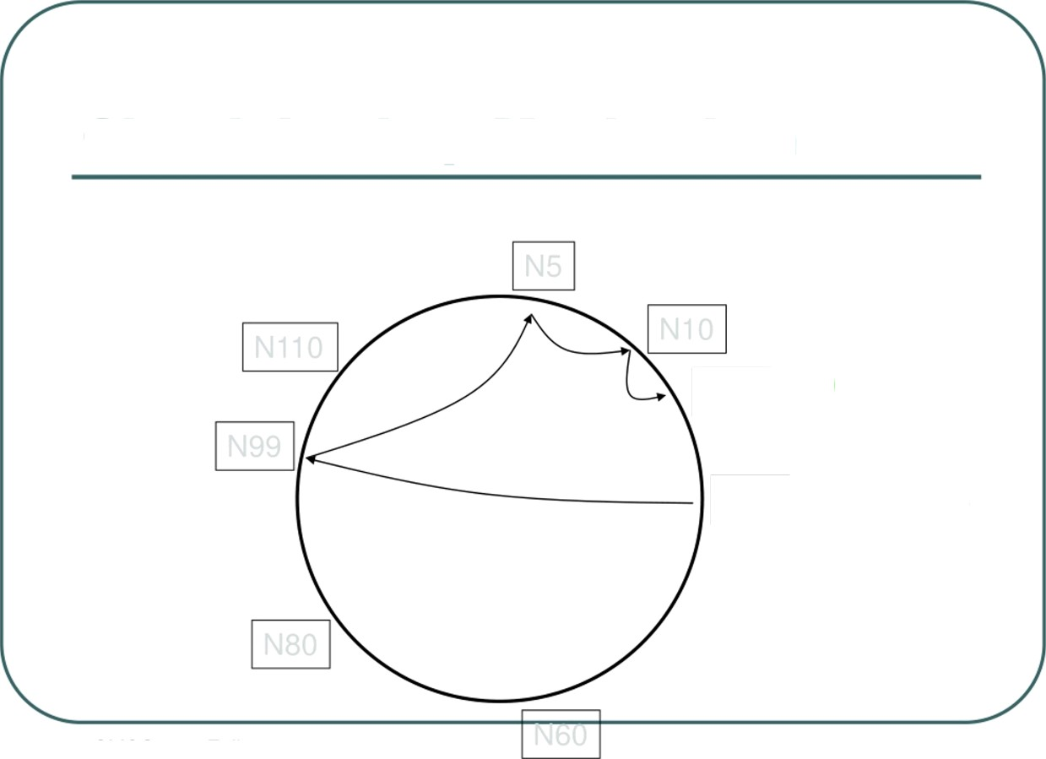
Chord: Lookup Mechanism
K19
Lookup(K19)
CMSC 621, Fall 2007

Slide 27
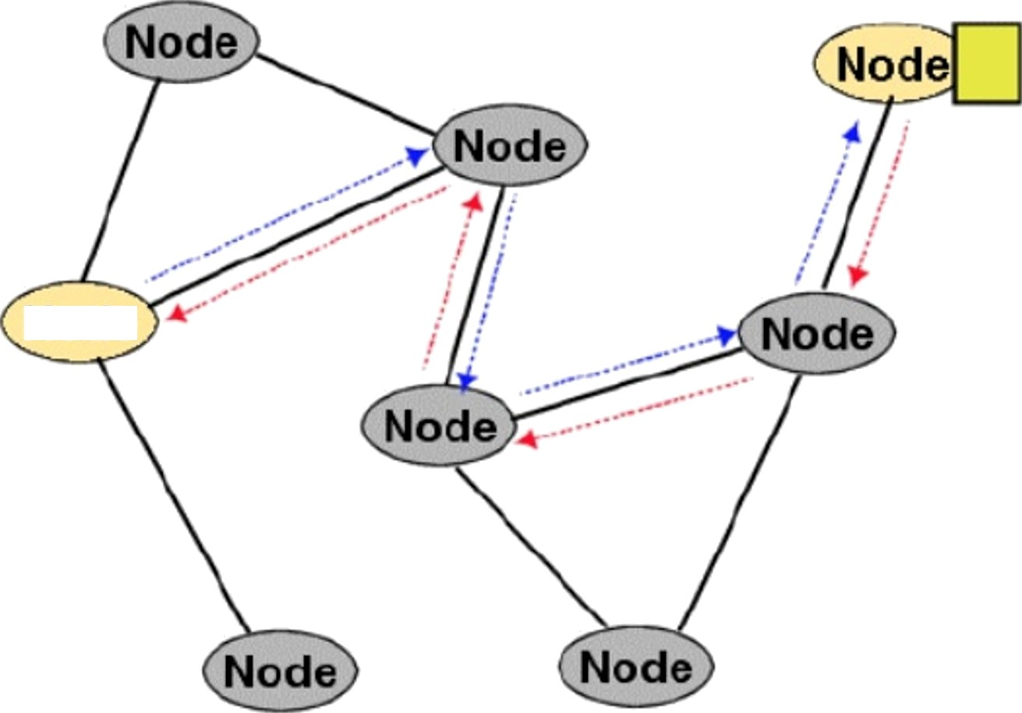
Freenet
The query is forwarded from node to node using the routing table, until it reaches the node which has the requested data.
The replay is passed back to the original node following the reverse path.
Node

Slide 28

Pastry
Completely decentralized, scalable, and self-
organizing; it automatically adapts to the
arrival, departure and failure of nodes.
Seeks to minimize the distance messages
travel, according to a scalar proximity metric
like the number of IP routing hops.
In a Pastry network,
Each node has a unique id, nodeld.
Presented with a message & a key, Pastry node
efficiently routes the message to the node with a
nodeld that is numerically closest to the key.

Slide 29
CAN (Content Addressable Network)
The network is created in a tree-like form.
Each node is associated to one in the upper
level an to a group in the lower level.
A query travels from the uppermost level down through the network until a match is found or until it reaches the lowermost level.
For its query model, scalability is an issue.

Slide 30
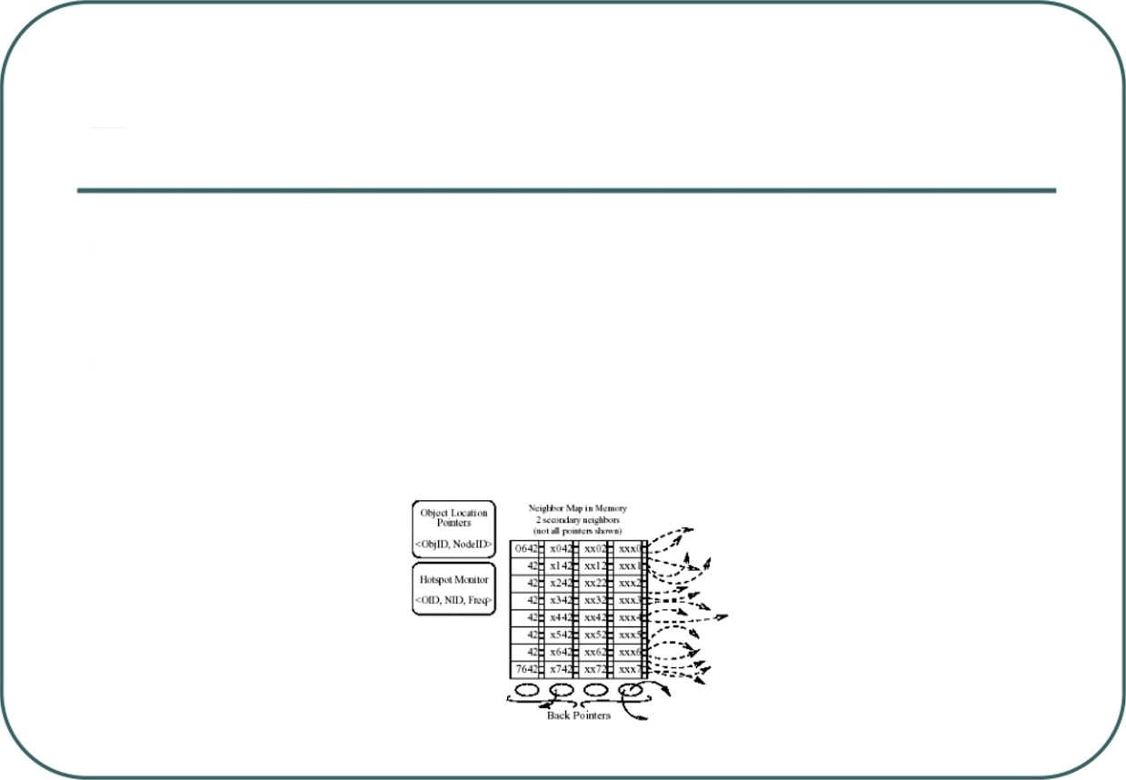
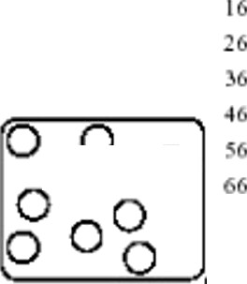
Tapestry
Self-administered, self-organized, location independent, scalable, fault-tolerant
Each node has a neighbor map table with neighbor information.

Slide 31

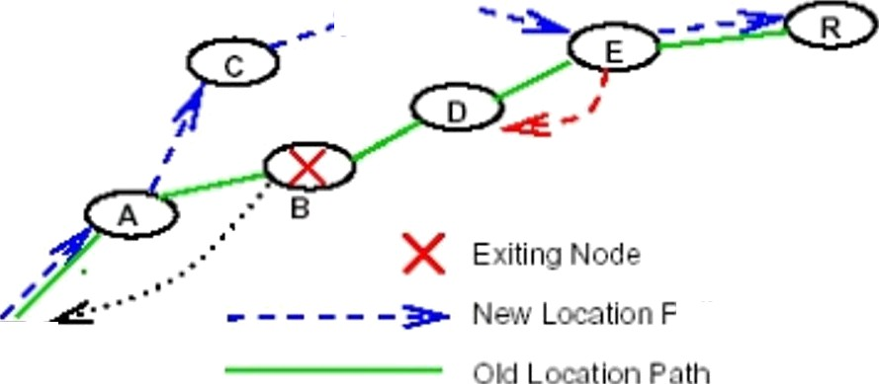
Tapestry Cont.
The system is able to adapt to network changes because it algorithms are dynamic.
This also provides for Fault-handling

Slide 32

When to consider unstructured P2P systems
The placement of content (files) is completely unrelated to the overlay topology.
In an unstructured network, content typically needs to be located. Searching mechanisms range from brute force methods such as flooding the network with propagating queries in a breadth-first or depth-first manner until the desired content is located, to more sophisticated and resource-preserving strategies that include the use of random walks and routing indices. The searching mechanisms employed in unstructured networks have obvious implications, particularly in regards to matters of availability, scalability, and persistence.
Unstructured systems are generally more appropriate for accommodating highly transient node populations.
Some representative examples of unstructured systems are Napster, Publius, Gnutella, Kazaa and Freehaven, et.

Slide 33

When to consider Structured P2Psystems
In structured networks the overlay topology is tightly controlled and files (or pointers to them) are placed at precisely specified locations.
These systems essentially provide a mapping between content (e.g. file identifier) and location (e.g. node address), in the form of a
distributed routing table, so that queries can be efficiently routed to the node with the desired content.
Structured systems oXer a scalable solution for exact-match queries,
i.e. queries in which the exact identifier of the requested data object is
known (as compared to keyword queries). Using exact-match queries
as a substrate for keyword queries remains an open research problem for distributed environments
A disadvantage of structured systems is that it is hard to maintain the struc|ure required for efficiently routing messages in the face of a very
transient node population, in which nodes are joining and leaving at a
high rate.
Typical examples of structured systems include Chord, CAN, Tapestry et cetera.

Slide 34
Conclusion
This table shows a classification of peer-to-peer content distribution systems and location and routing infrastructures in terms of their Network structure, with some typical examples.
Centralizauon Paraal
HybnJ
None
Kazaa, Morpheus, Gnute lla, Edutella
Unstructured
Napster, Pub ltus
Gnute11a,
Freehaven
Structure d lnfras truc tures
Chord, CAN, Tapestry, Pastry
OceanStore, Mnem os yne, Scan, PAST, Y ademli a, Tarzan
Structure d
Systems

Slide 35

References
B. Pourebrahimi, K. bertels and S. Vassiliadis. A survey of Peer-toPeer Networks, !‹t
Ion Stoica, Robert morris, david Karger, M. Frans Kaashoek and Hari Balakrishnan. Chord: A Scalable Peer-to-Peer Lookup Service for Internet Applications,
Ismail Guvenc and Juan Jose Urdaneta. Peer to Peer File Sharing: A Survey,
Nelson Mina. Distributed Systems Topologies: Part 1,
’-. •. ’ !','” ñ. —| e'
Stephanos Androutsellis-Theotokis and Diomidis Spinellis. A survey of peer-to-peer content distribution technologies. ACM Computing Surveys, 36(4):335—371, December 2004.

Slide 36
Questions?
CMSC 621, Fall 2007

